Slide 1

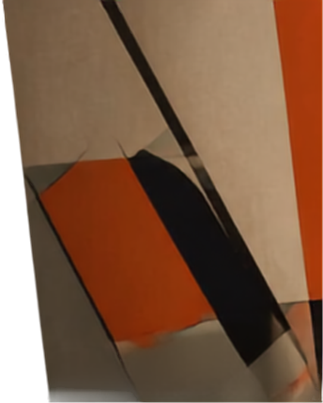
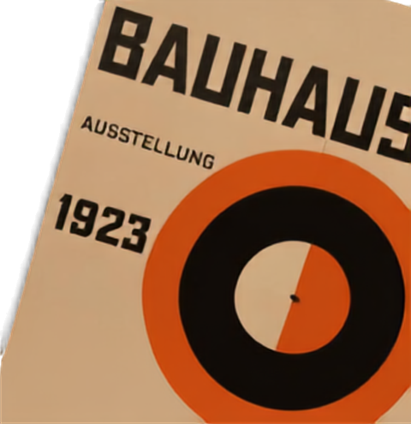

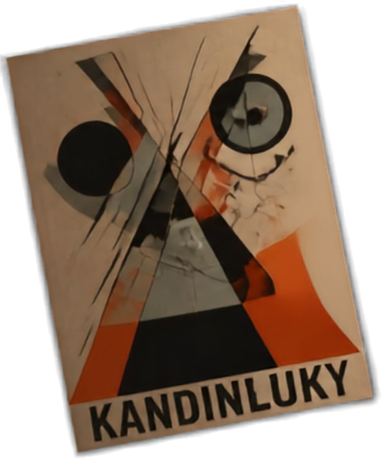
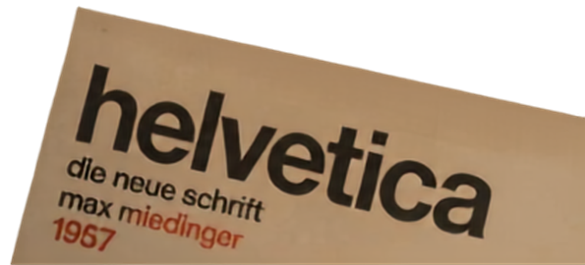
THE HISTORY OF GRAPHIC DESIGN AND INFLUENTIAL ART MOVEMENTS
Exploring the past to understand today's design
Graphic Design
Lecture 1

Slide 2

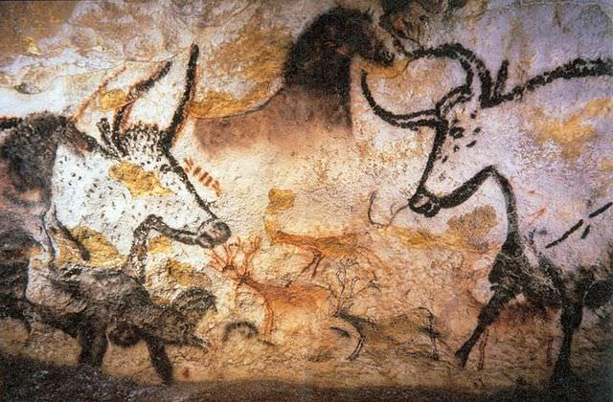
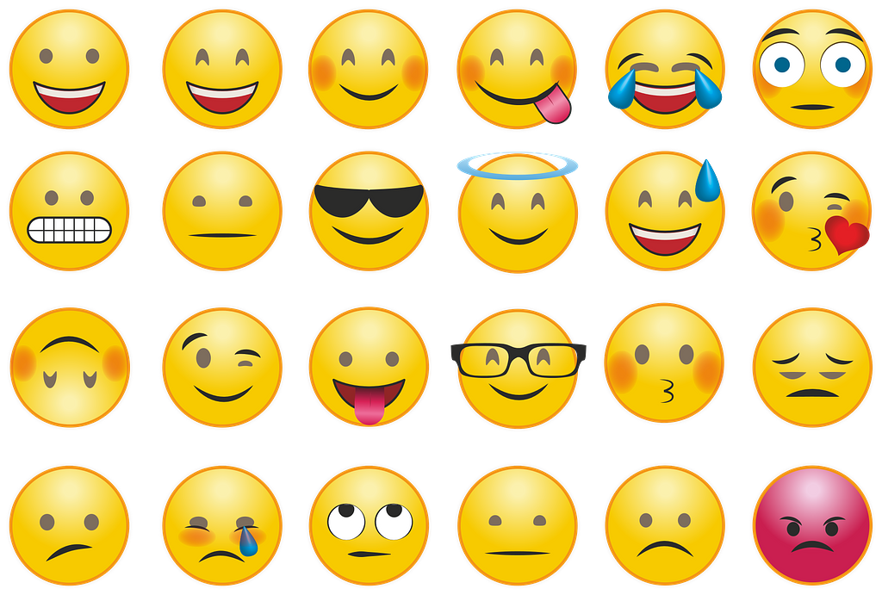
THE ORIGINS OF COMMUNICATIONS.
Visual Beginnings
Human communication started with symbols
Historical Roots
Deeply tied to art, craft, and architectural practice
The Goal
Spreading information between components of society
Lascaux Cave Pictographs
Notes:
One of the several Palaeolithic cave paintings found at Lascaux, a network of caves in southwestern France.
Image from: https://www.worldhistory.org/image/3539/cave-painting-in-lascaux/
Cave Painting in Lascaux - World History Encyclopedia
License & Copyright
Original image by Prof saxx. Uploaded by Cristian Violatti, published on 07 January 2015. The copyright holder has published this content under the following license: Creative Commons Attribution-NonCommercial-ShareAlike. This license lets others remix, tweak, and build upon this content non-commercially, as long as they credit the author and license their new creations under the identical terms. When republishing on the web a hyperlink back to the original content source URL must be included. Please note that content linked from this page may have different licensing terms.
Image from: https://picryl.com/media/some-emojis-which-are-used-in-whatsapp-a67148
Some Emojis which are used in WhatsApp — PICRYL - Public Domain Media Search Engine

Slide 3




THE ROOTS.
THE MOVEMENTS.
THE IMPACT.
Graphic design is the art of visual communication—shaping ideas through type, image, and layout.
From early printing to today's digital tools,
it has evolved with culture and technology.
Understanding its past reveals why great
design still resonates today.
EARLY PRINTING
INDUSTRIAL AGE
MODERN MOVEMENTS
DIGITAL ERA
the power of the printed word takes shape
new media and mass communication emerge
form, function, and ideas redefine design
technology expands creative possibilities

Slide 4

WHY HISTORY
MATTERS.
Context and Meaning
Design responds to culture
Visual Trends
Understanding where styles originate
Efficiency
Learning from the past to avoid “reinventing the wheel”
From the printing press to electronic media
Notes:
Image from https://www.pickpik.com/phone-screen-technology-mobile-internet-telephone-123828#google_vignette

Slide 5

WHY HISTORY
MATTERS.
Can you think of more reasons why knowing about the past will make you a better graphic designer?

Slide 6

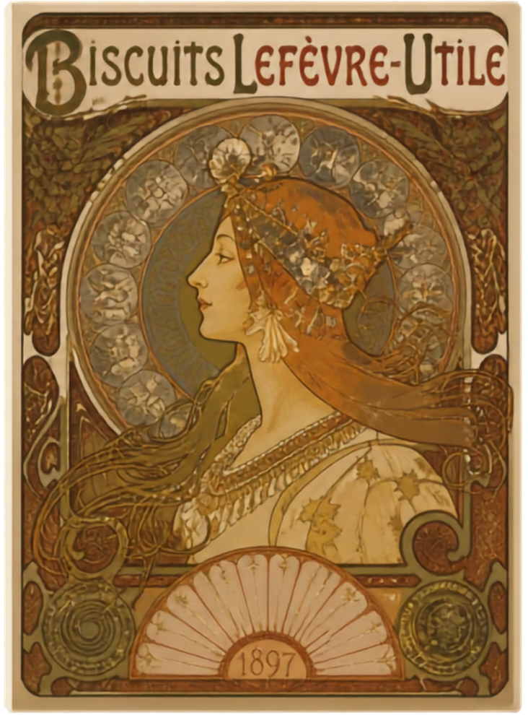
Early Influences
Art Nouveau shaped the look and language of early graphic design
Organic lines, floral motifs, and decorative typography
Alphonse Mucha and Henri de Toulouse-Lautrec
A lasting impact on posters and advertising
Notes:
Timeline: Art Nouveau emerged about thirty years later, peaking between 1890 and 1910 across Europe and the United States. [1, 2, 3]
Design Style: Art Nouveau embraced long, sinuous, asymmetrical "whiplash" curves and modern industrial materials like iron and glass. [1, 2, 3]
Shared Ideals: Movement rejected rigid 19th-century academic traditions and sought to erase the barrier between fine arts and applied decorative arts. [1, 2]

Slide 7




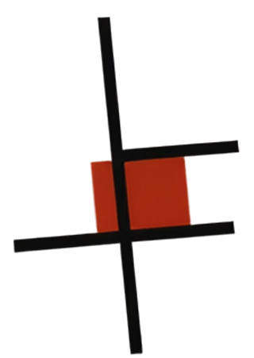

BAUHAUS AND
BAUHAUS
MODERNISM.
A shift toward functional, minimalist design.
AUSSTELLUNG
WEIMAR
JULI–SEPT
Form follows function.
Simplicity. Art and technology together.
1923
Clarity and geometry
define a new visual language.
Bauhaus school founded in 1919
still shaping design education worldwide.

Slide 8


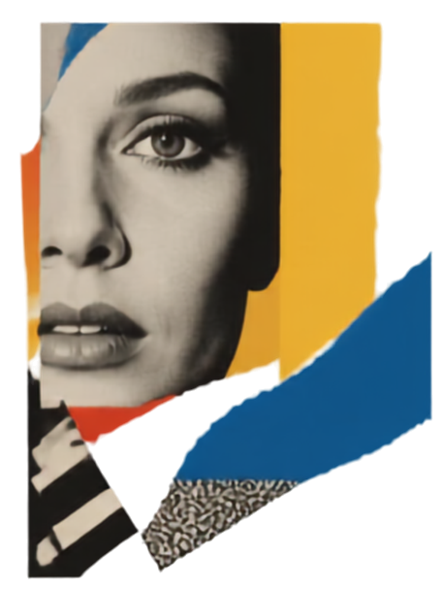


POSTMODERNISM AND CONTEMPORARY
BAUHAUS
The Museum of Contemporary Art, Los Angeles
AUSSTELLUNG
TRENDS.
IMARTINI
Postmodernism embraces eclecticism, irony, and historical references
WEIMAR
Breaks the rules modernism set
JULI–SEPT.
Contemporary design draws freely from the past
1923
Art & Design
1984
Context, meaning, and play shape the message
MODERNISM
VS.
POSTMODERNISM
clarity through simplicity
meaning through mix
form follows function
form follows expression

Slide 9
OTHER ART MOVEMENT
TRENDS.
Do a quick search to find other art movements that influence modern graphic design.

Slide 10

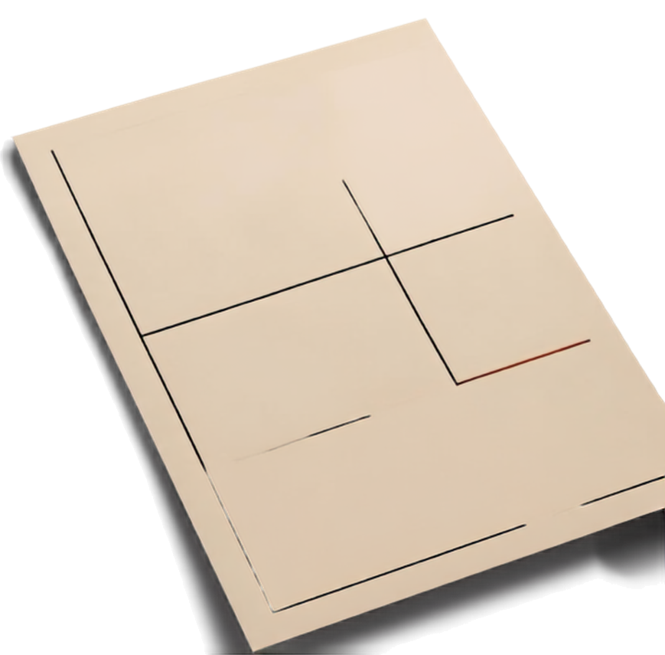

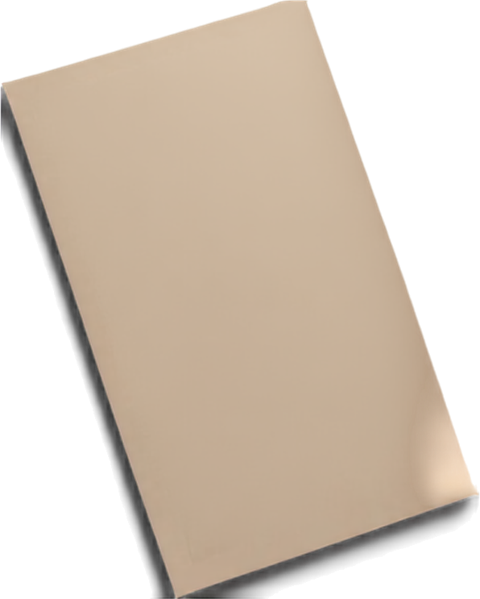
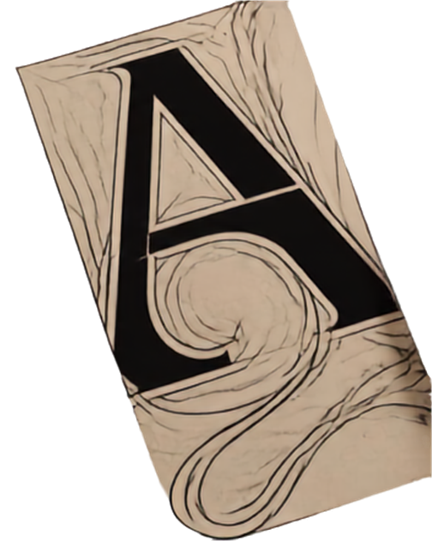
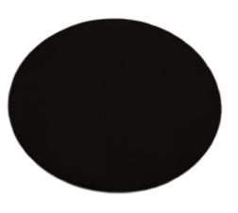
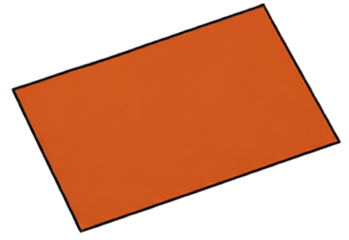

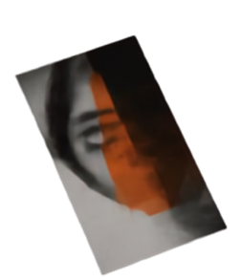

LASTING
IMPACTS
1919 – 1933
bauhaus
ON TODAY'S
GRAPHIC DESIGN
01
TYPOGRAPHY INNOVATION
form
and
function
art nouveau's decorative letterforms and bauhaus typography continue to inspire
02
GRID & MODULAR LAYOUTS
modernist principles of order and structure shape how we organize information
VISUAL STORYTELLING & ECLECTIC STYLE
DES
GN
03
postmodernism's mix of references and narrative-rich visuals remains influential
04
ART & TECHNOLOGY INTEGRATION
pauhaus ideals of uniting art, craft, and technology inform digital design today

Slide 11

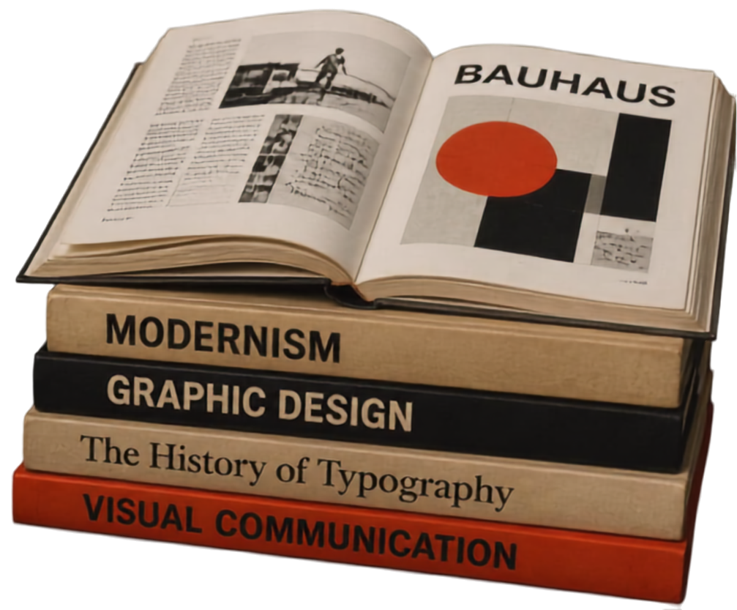
SUMMARY AND NEXT STEPS.
Art movements continue to shape how we communicate.
Explore historical works for ideas that inspire.
Dive deeper with books, archives, and exhibitions.
Understanding history empowers innovative design.

Slide 12
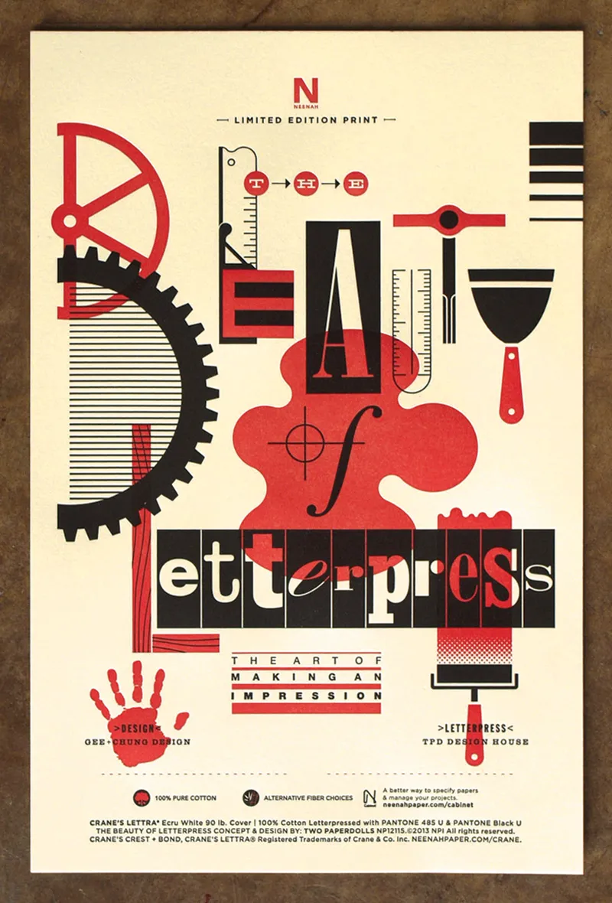
THE “BEFORE”
CHITIQUE.
In your own words, how do you see this design before you have learned design theory?
Notes:
Image from: 10 Beautiful, Promo-Driven Poster Designs – PRINT Magazine
https://www.printmag.com/design-inspiration/10-beautiful-promo-driven-poster-designs/

